Slide 1
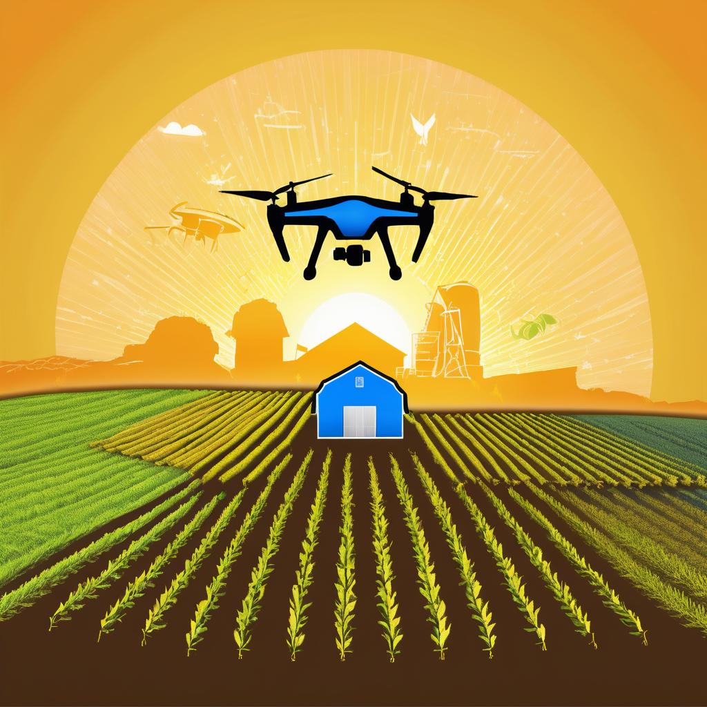
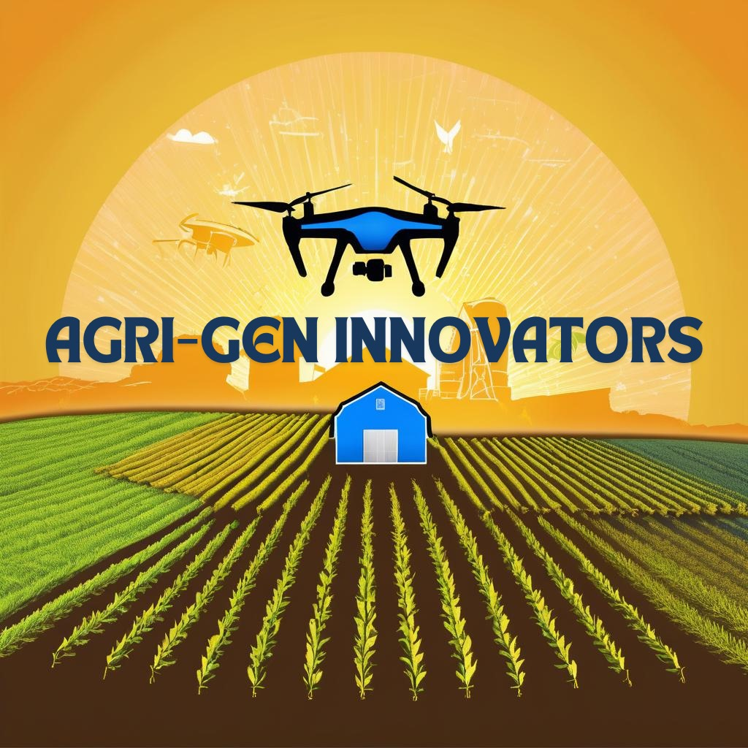

Slide 2
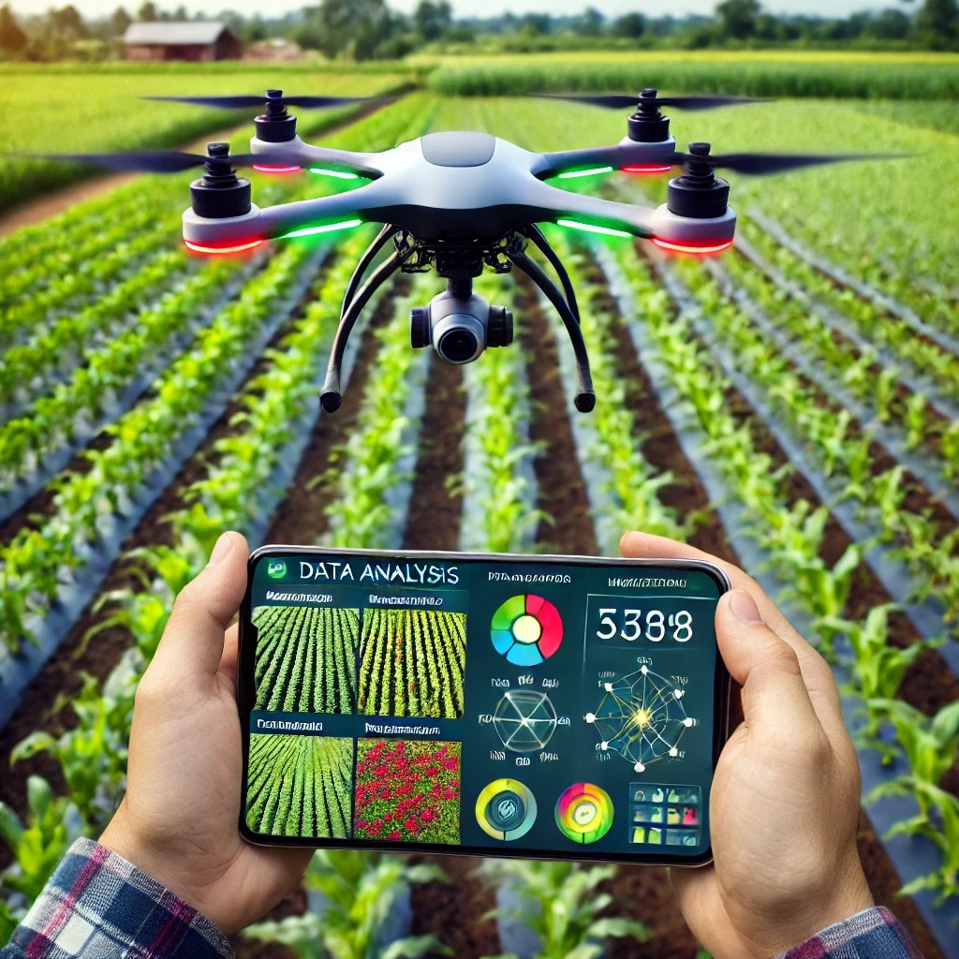
Problem statement
Farmers struggle to efficiently monitor and manage crop health across fields due to limited accuracy in traditional tools, leading to suboptimal resource use and increased costs. Current methods often fail to provide the high-resolution insights needed for precise, data-driven interventions on crop health, water stress, and nutrient levels. This project aims to develop an advanced, drone-based solution using NDVI, GNDVI, NDRE, and NDWI sensors to deliver accurate, real-time insights on crop conditions. By enabling targeted, timely interventions, this approach supports optimized yield, resource conservation, and sustainable farming practices.

Slide 3
Existing solutions like satellite imagery, drone platforms, IoT sensors, and GIS software provide crop health data but lack field-level precision, real-time multi-index analysis, and comprehensive integration. Our project addresses these gaps with high-resolution drone monitoring across multiple indices, delivering actionable insights for targeted, sustainable farming.
How Our Project Differs: Our project aims to create a more advanced, customizable solution that integrates multiple vegetation indices (NDVI, GNDVI, NDRE, NDWI) to monitor plant health, water stress, and nutrient levels more comprehensively. Additionally, it includes optimized drone flight planning and real-time data processing to offer actionable insights for targeted field interventions—enabling more timely, efficient, and sustainable farming practices than currently available solutions.

Slide 4
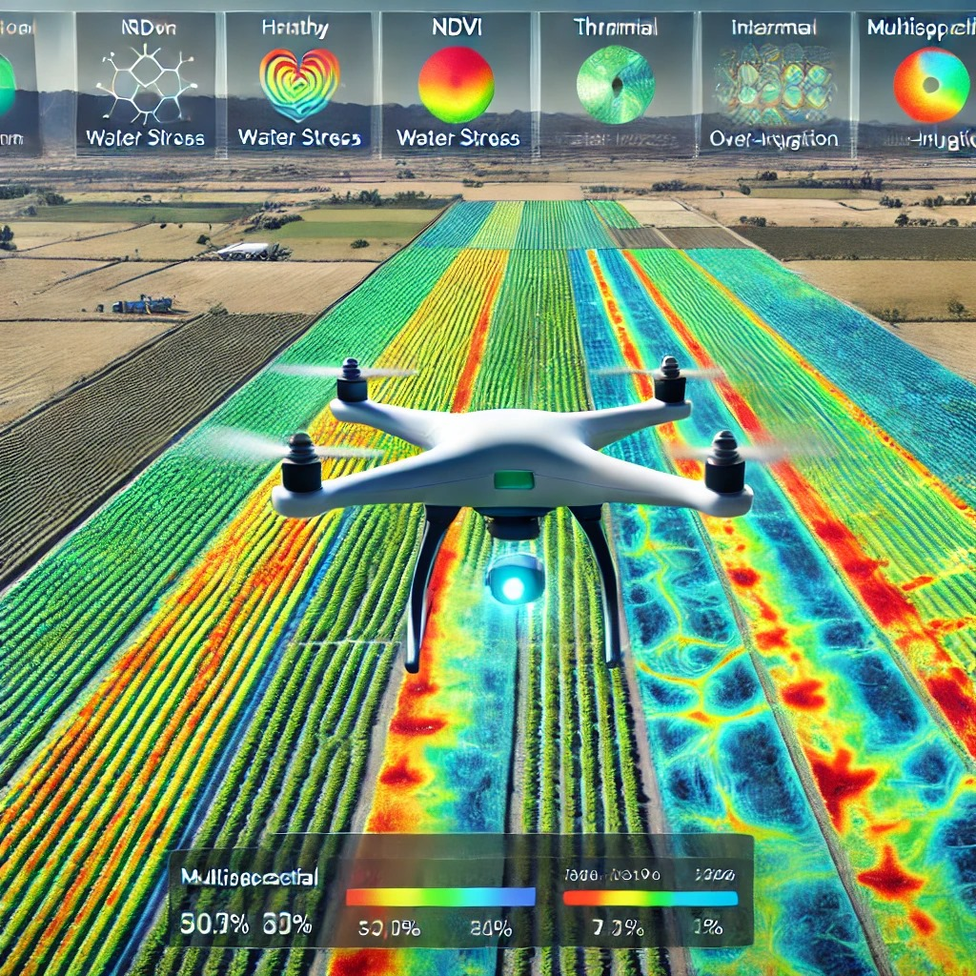
OPPORTUNITIES
Advanced Drones: Enhanced drones with longer battery life and automated flight paths can efficiently collect high-resolution data over larger areas.
Diverse Sensors: Affordable, compact sensors (NDVI, GNDVI, NDRE, thermal, multispectral) allow for comprehensive monitoring of crop health.
Real-Time Processing: Advances in edge computing and cloud technology enable quick analysis of large datasets, providing immediate insights.
AI and Machine Learning: Improved algorithms can predict crop health and optimize resource distribution for effective interventions.
IoT Integration: Combining IoT devices with drones enables seamless remote monitoring and data management for farmers.
Cost-Effective Data Storage: Lower costs and better image resolution facilitate long-term data tracking and analysis for informed decision-making.
These advancements enhance efficiency and sustainability in large-scale agriculture.

Slide 5
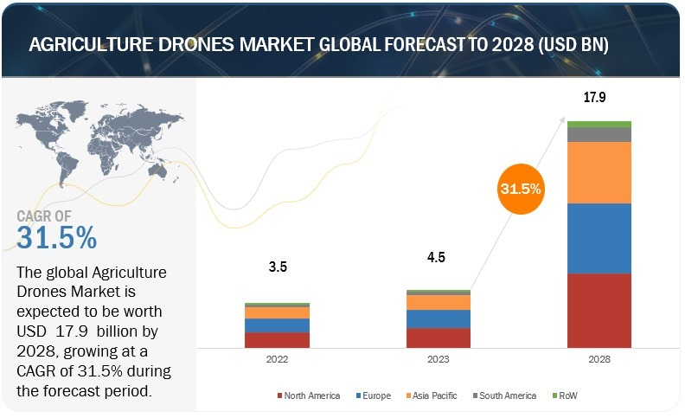
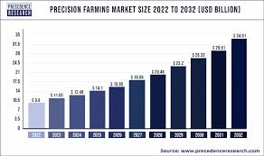

Slide 6
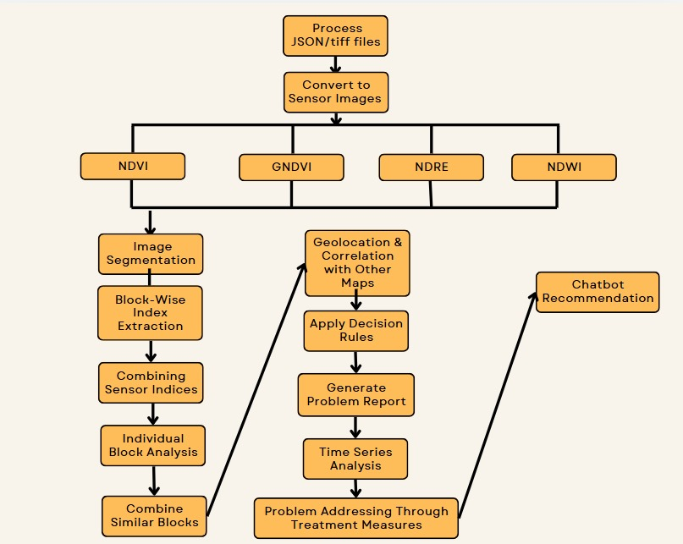
FLOW OF EXECUTION

Slide 7
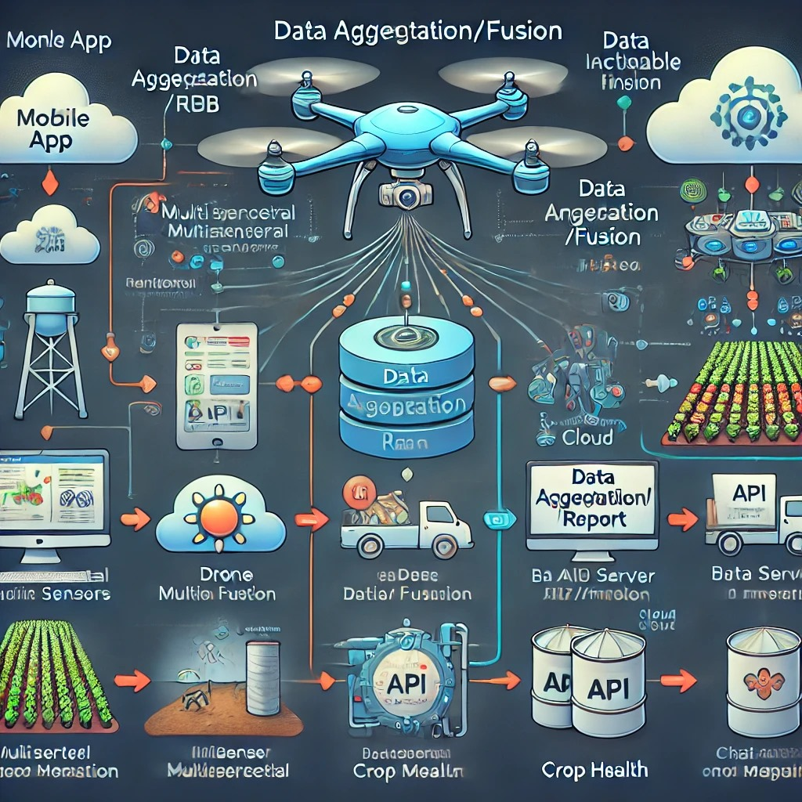
TECH STACK
Programming Languages: Kotlin, Java, Python
Android Studio
UI Frameworks: XML Layouts
Cloud Platforms: Firebase (Firestore, Storage, Analytics, Realtime Database, Cloud Functions)
Local Storage: SharedPreferences, DataStore
Machine Learning Frameworks: Py-Torch
Mapping Libraries: Google Maps SDK, Mapbox SDK
NLP and Chatbot Frameworks: TensorFlow Lite (for custom NLP models)
GeoFencing:GPS/GNSS,RFID

Slide 8
BENEFITS FOR FARMERS
Benefits for Farmers
Improved Crop Monitoring: Early detection of crop stress and diseases through multi-spectral sensors allows for timely corrective actions.
Resource Optimization: Targeted interventions reduce waste and lower costs by optimizing water, fertilizers, and pesticides.
Enhanced Yield: Precision agriculture increases crop yield and quality, boosting farmers' income with actionable insights.
Sustainability: Minimizing chemical overuse and optimizing resource usage promotes environmentally friendly farming practices.
Time Efficiency: Drones automate data collection, saving time and labor costs, while remote data access simplifies field management.
Better Decision-Making: Historical data analysis and predictive analytics help farmers plan effectively and improve future practices.
User-Friendly Technology: An intuitive app interface makes it easy for farmers to interpret data and take action, with training support enhancing digital literacy.
Community Building: Collaboration among farmers fosters shared knowledge and best practices.

Slide 9
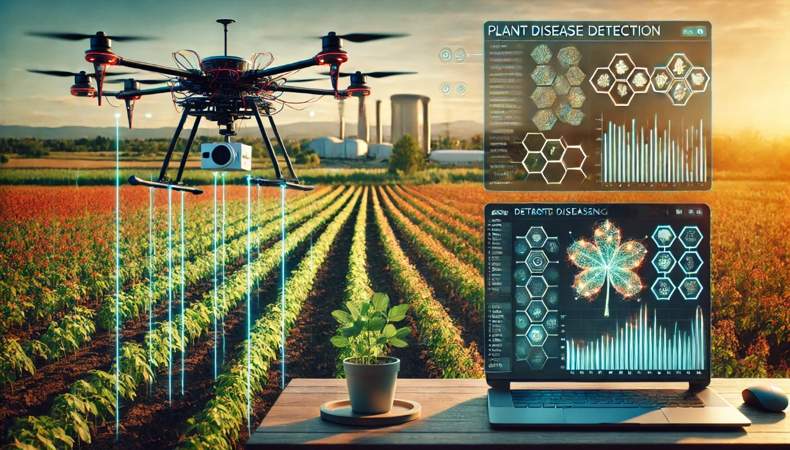
FUTURE SCOPE (PLANT DISEASE DETECTTION)
Process:
Data Collection: Gather labeled images of healthy and diseased plants.
Image Preprocessing: Enhance images through normalization and augmentation.
Feature Extraction: Use Convolutional Neural Networks (CNNs) to identify disease-related features.
Model Training: Train and evaluate models for disease classification.
Real-Time Detection: Deploy models for instant analysis of new plant images.
Benefits:
Early Detection: Reduces crop loss through prompt action.
Resource Optimization: Minimizes pesticide and fertilizer use.
Data-Driven Insights: Aids farmers in better management decisions.

Slide 10
THANK
YOU

